Slide 1
Deployment and Operation
Lecturer: Ngo Huy Bien
Software Engineering Department
Faculty of Information Technology
VNUHCM - University of Science
Ho Chi Minh City, Vietnam
nhbien@fit.hcmus.edu.vn

Slide 2

Objectives
To deploy software.
To operate a software system.

Slide 3

Contents
Deployment Plan.
Operation Plan.
Deployment and Operation Tools.

Slide 4

References

Slide 5


Fresh Deployment Plan
Physical environment
Hardware
3rd party software
Software being deployed
Database being deployed
Deployment documentation
Deployment training
Production testing

Slide 6

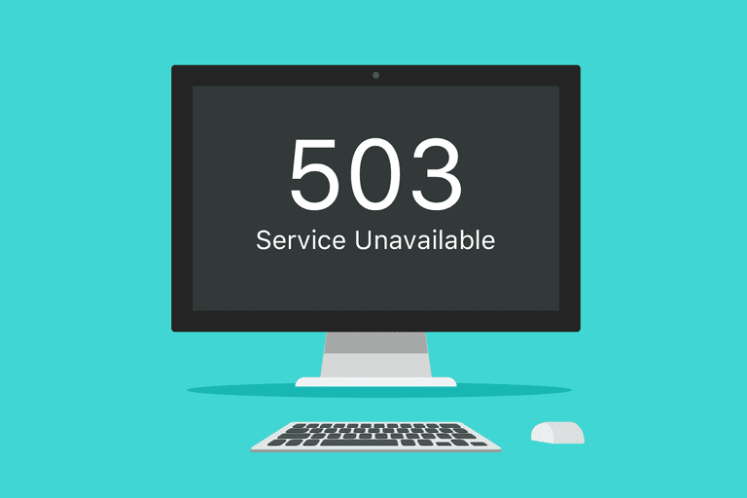
Why is Production Deployment Hard?

Slide 7

Upgrade Deployment Plan
Physical environment
Hardware
3rd party software
Software being deployed
Patches
Database being deployed
Upgrading schema, data migration
Rollback plan
Deployment documentation
Deployment training
Production testing

Slide 8

Example Rollback Plan
Make a backup of the existing code and data files and database.
Update the code and database.
If problem occurs then
Delete the new code.
Revert the code using the code backup.
Revert the data files using the data files backup.
Revert the database using the database backup.

Slide 9

The Point of No Return

Slide 10

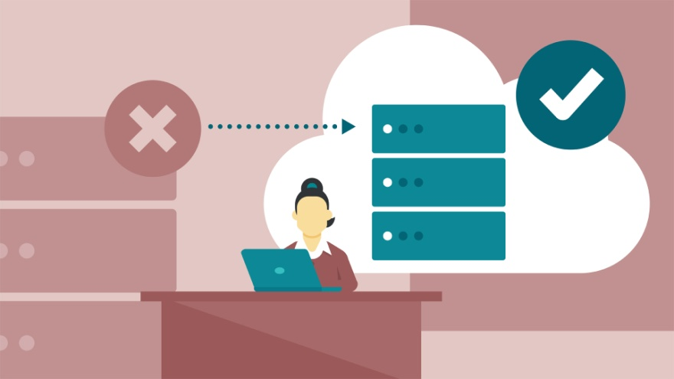
High Availability
Cold backup
Warm standby
Periodic (nightly) data synchronization.
Hot failover
Real-time data synchronization.

Slide 11

Hands-On Exercises
https://aws.amazon.com/free/
https://www.heroku.com/what
https://docs.docker.com/get-docker/

Slide 12
Further Reading
https://www.amazon.com/Deployment-Operations-Software-Engineers-Engineering/dp/B09XT6L7T5

Slide 13

Thank You & See You Again

